Slide 1


Experimental Performance Analysis of
An Estes Rocket Engine
A Senior Project
Team Members - Zach Raboin, Lucas Simmonds, Charlie Nitschelm
Advisor - Alireza Ebadi
University of New Hampshire
Students for the Exploration and Development of Space

Slide 2

Objective
Develop a well-designed testing procedure and full-proof analysis to determine the primary performance characteristics of rocket engines and compare their efficiency and power to engines used in the aerospace industry.
Pressure and thrust measured with SenSym 300 psi Pressure Transducer and 100 lbf Load Cell.
Pressure tap incorporated to shield transducer from high temperature combustion.
Secured via high temperature epoxy and zipties!
University of New Hampshire
Students for the Exploration and Development of Space

Slide 3
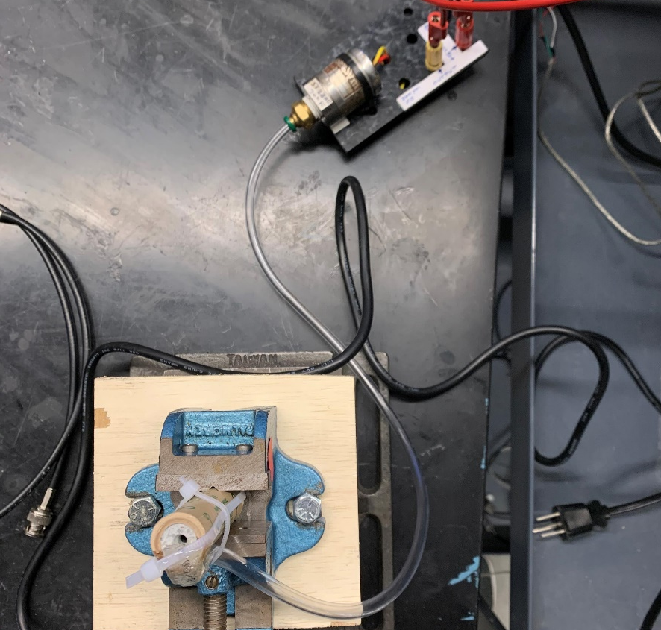

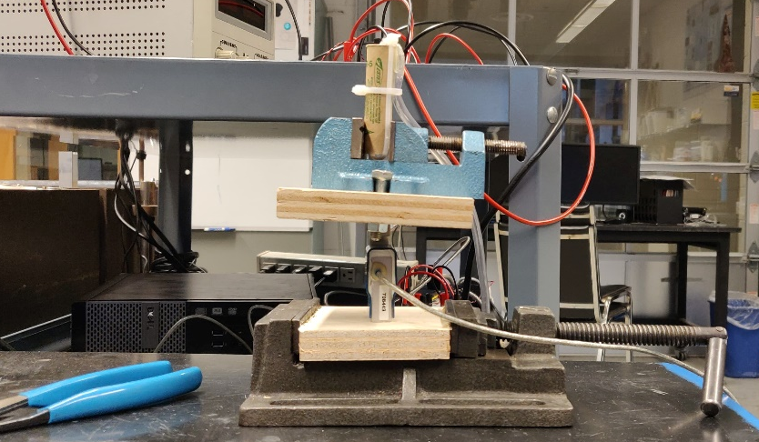
Pressure Transducer
Experimental Setup
A load 100 lbf load cell is used to capture the thrust of the engine
A 300 psig pressure transducer is used to measure the pressure at the exit of the nozzle
Nozzle Exit
Load Cell
University of New Hampshire
Students for the Exploration and Development of Space

Slide 4
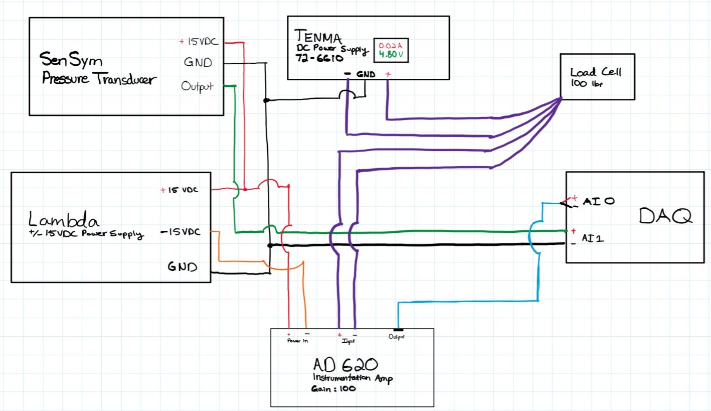

Data Acquisition Setup
$± 15$ VDC power supply is used for the pressure transducer
A 4.8VDC power supply is used for the load cell
An AD620 Instrumentation Amplifier is used to provide a gain of 100 for the sensors
A Data Acquisition instrument is used to read the data into LabView
Data is then analyzed using MATLAB 2019a
University of New Hampshire
Students for the Exploration and Development of Space

Slide 5

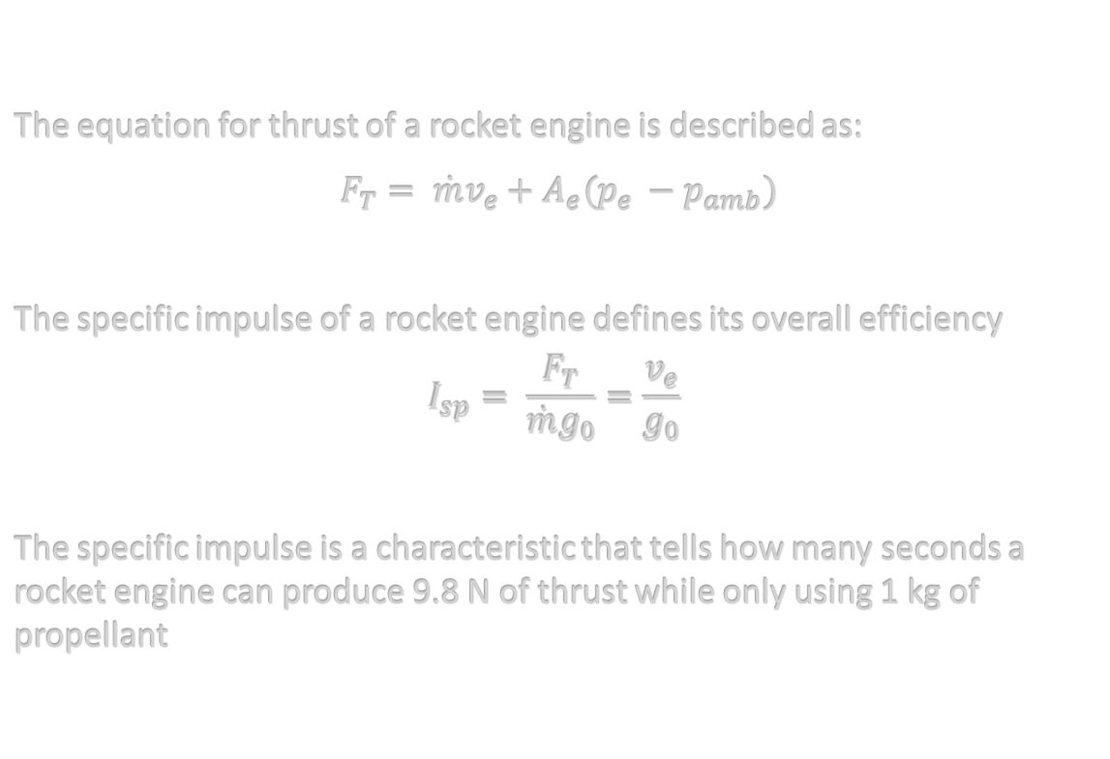
Analysis
The equation for thrust of a rocket engine is described as:
$F_{T}= \dot{m}v_{e}+A_{e}(p_{e} −p_{amb})$
The specific impulse of a rocket engine defines its overall efficiency
$$I_{sp}= \frac{F_{T}}{\dot{m}g_{0}}=\frac{v_{e}}{g_{0}}$$
The specific impulse is a characteristic that tells how many seconds a rocket engine can produce 9.8 N of thrust while only using 1 kg of propellant
University of New Hampshire
Students for the Exploration and Development of Space

Slide 6
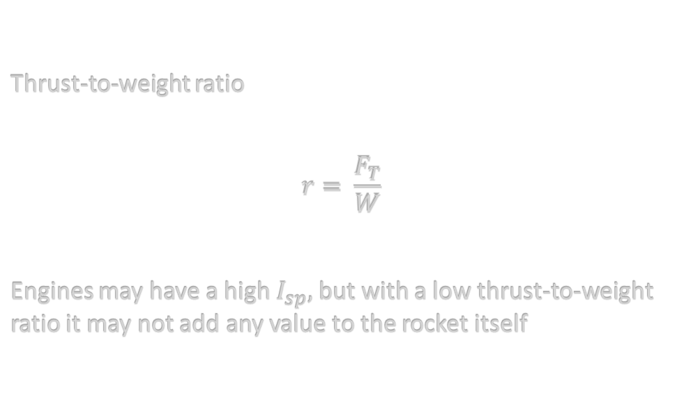
Analysis
Thrust-to-weight ratio
$$r= \frac{F_{T}}{W}$$
Engines may have a high $I_{sp},$but with a low thrust-to-weight ratio it may not add any value to the rocket itself
University of New Hampshire
Students for the Exploration and Development of Space

Slide 7
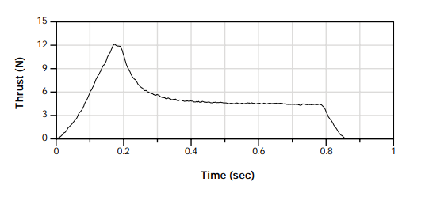
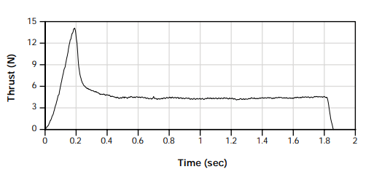
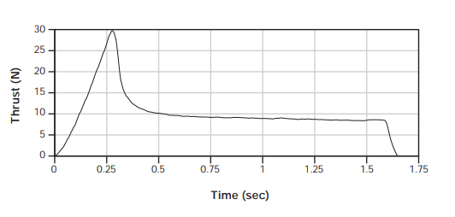
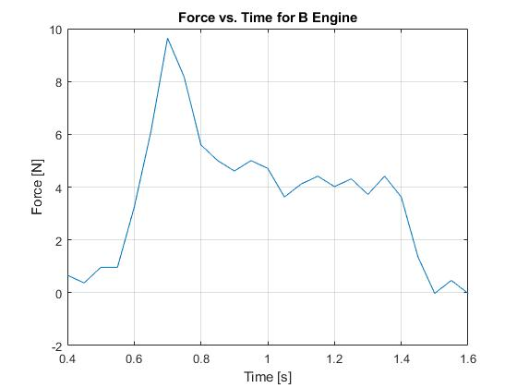
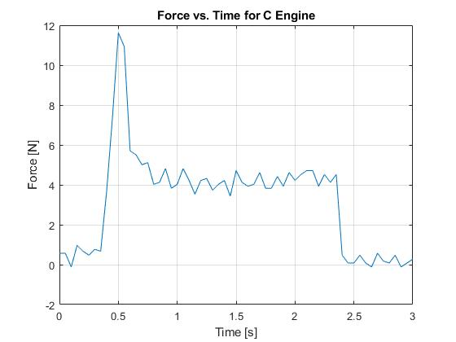
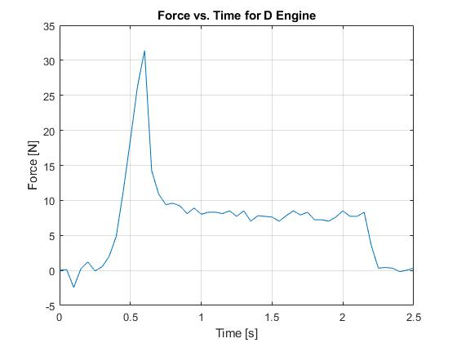
Thrust Curve - Comparison

Slide 8
Next Steps
Analyze the data to obtain engine parameters
Compare to industry engines (Merlin, Space Shuttle)
Write report to allow others to make the same setup, test and analysis

